Slide 1
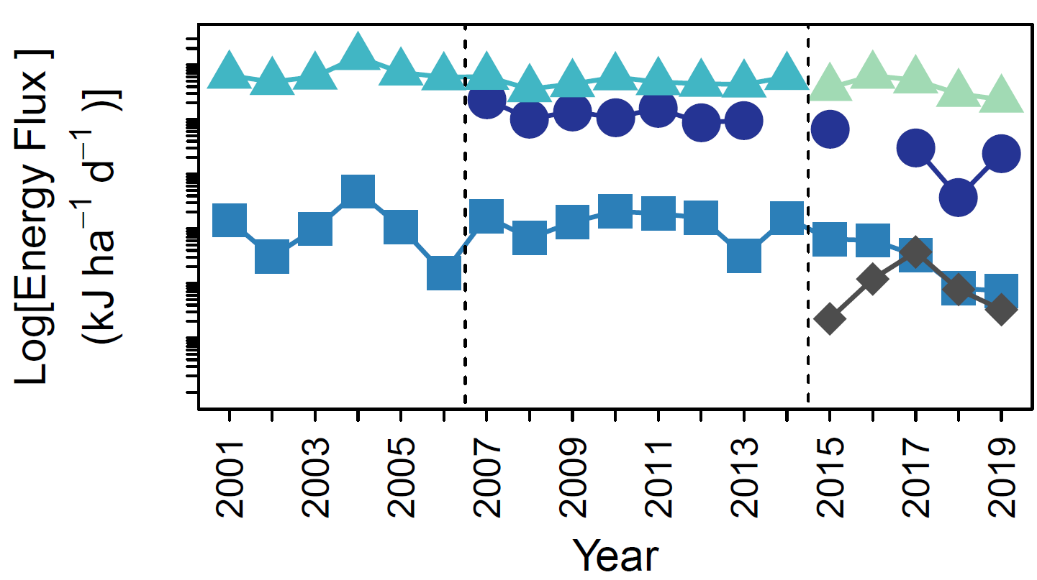
30⁹
10⁷
10⁵
10³

Slide 2
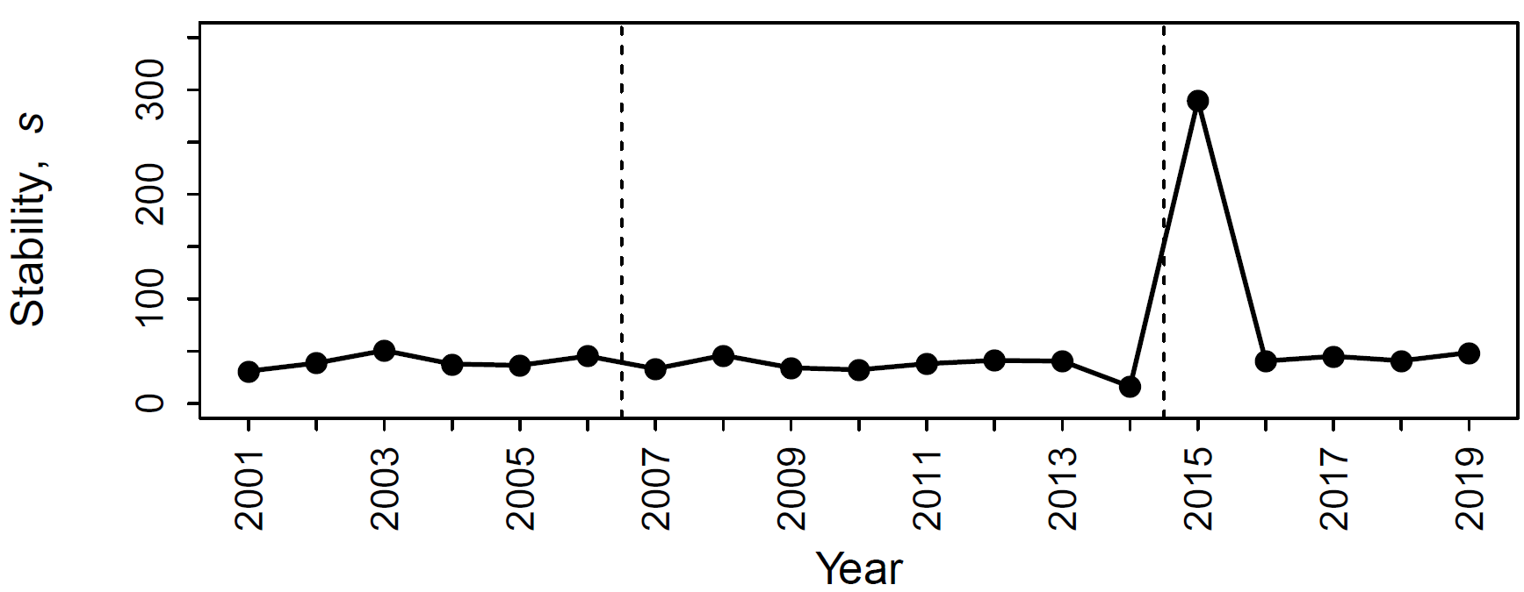




First period
Second period
Third period
Decreasing stability

